Slide 1

Introduction to Data Analysis (DATA 1200) Assignment #5 – Clustering Professor: Omar Altrad
Prepared by Group – 6
Sheetalben Mukeshbhai Jadav - 100951636
Karthic Easwar Sivapragasam - 100963337
Denish Surati - 100897255
Sayali Kumbhar - 100950732

Slide 2

Table of Contents
Description of the Analysis Conducted
Elbow Method Clustering Analysis
Silhouette Method Clustering Analysis
Gap Statistic Clustering Analysis
Insights from the newly created clusters

Slide 3
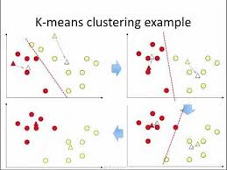
Analysis on K-means cluster
We conducted K-means clustering using both the Elbow and Silhouette methods, the analysis will involve the following key steps:
1. Data Preparation
Loading the Dataset: Read the illnessstudy.csv file, which contains tumour measurement attributes (columns A to AD) and the diagnosis (column AE).
Data Preprocessing: Handle any missing values, normalize the features, and possibly encode the dependent variable for clarity, although it won't be used in unsupervised learning directly.
2. Exploratory Data Analysis (EDA)
Descriptive Statistics: Summary statistics for the dataset to understand the distribution and ranges of the features.
Visualization: Histogram or pair plots of features to inspect data distribution and relationships.

Slide 4
Analysis on K-means cluster
3. K-means Clustering
Elbow Method:
Plot the within-cluster sum of squares (WCSS) for a range of cluster numbers (k).
Identify the 'elbow point' where the WCSS starts to decrease more slowly, indicating an appropriate number of clusters.
Silhouette Method:
Calculate the silhouette scores for different numbers of clusters.
Use the silhouette score to determine the optimal number of clusters, which maximizes the average silhouette score.
4. Evaluation and Interpretation
Cluster Visualization: Visualize the clusters in 2D or 3D space using dimensionality reduction techniques like PCA (Principal Component Analysis) for easier interpretation.
Cluster Analysis: Analyze the characteristics of the clusters and compare them with the known diagnosis labels (Benign or Malignant) to see if there is a meaningful separation.

Slide 5
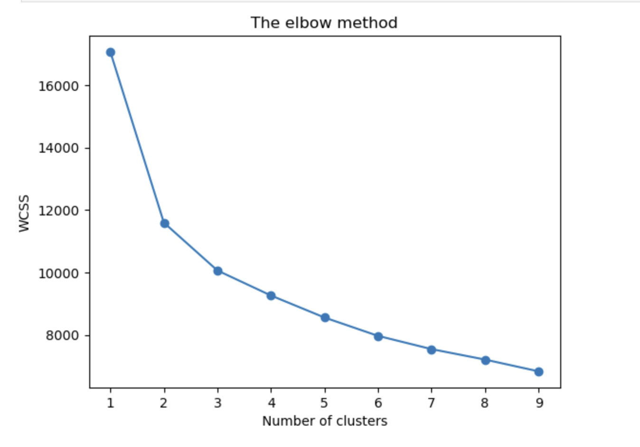
The Elbow and Silhouette Method required to optimize a K-means Model
Introduction
K-means Clustering: A method to partition data into distinct groups (clusters) based on similarity.
Optimal Number of Clusters: Important to ensure meaningful and well-defined clusters without overfitting.
Methods Used
Elbow Method:
Plots the Within-Cluster Sum of Squares (WCSS) against the number of clusters.
The optimal number of clusters is at the "elbow" point where the WCSS starts to decrease more slowly.
Silhouette Method:
Uses the silhouette coefficient to measure how similar an object is to its own cluster compared to other clusters.
Higher silhouette scores indicate better-defined clusters.

Slide 6
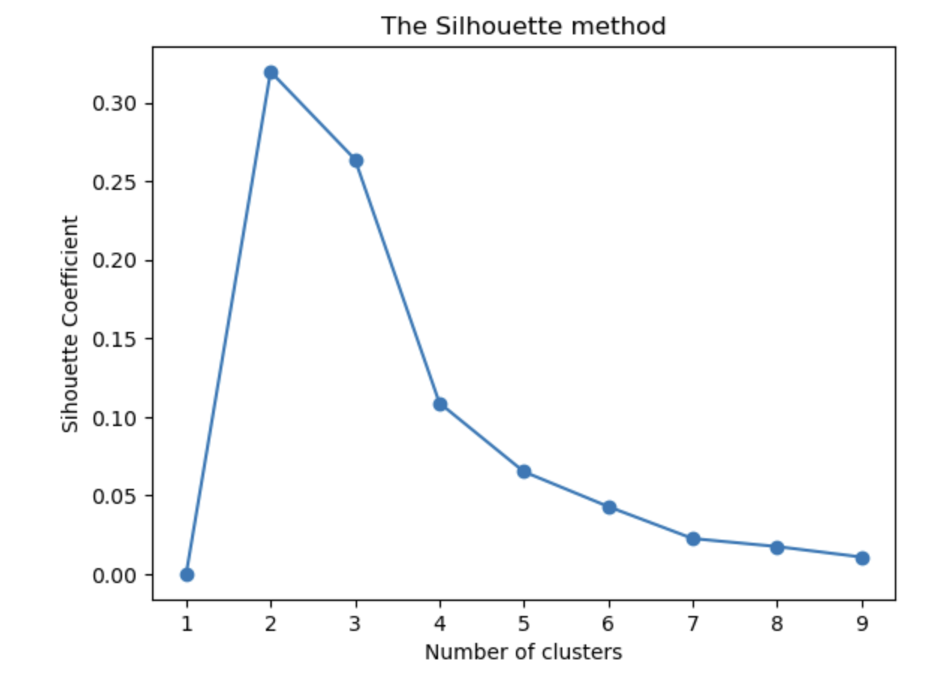
The Elbow and Silhouette Method required to optimize a K-means Model
Data Preparation
Preprocessing: The dataset was scaled using standard techniques to ensure all features contribute equally to the clustering process.
Elbow Method Analysis
Plot: WCSS vs. Number of Clusters.
Interpretation: Look for the "elbow" point where the decrease in WCSS slows down.
Conclusion: The elbow is observed at 3 clusters, suggesting this as a potential optimal number.
Silhouette Method Analysis
Plot: Silhouette Score vs. Number of Clusters.
Interpretation: Higher silhouette scores indicate better-defined clusters.
Conclusion: The highest silhouette score is observed for 3 clusters, indicating optimal clustering.

Slide 7
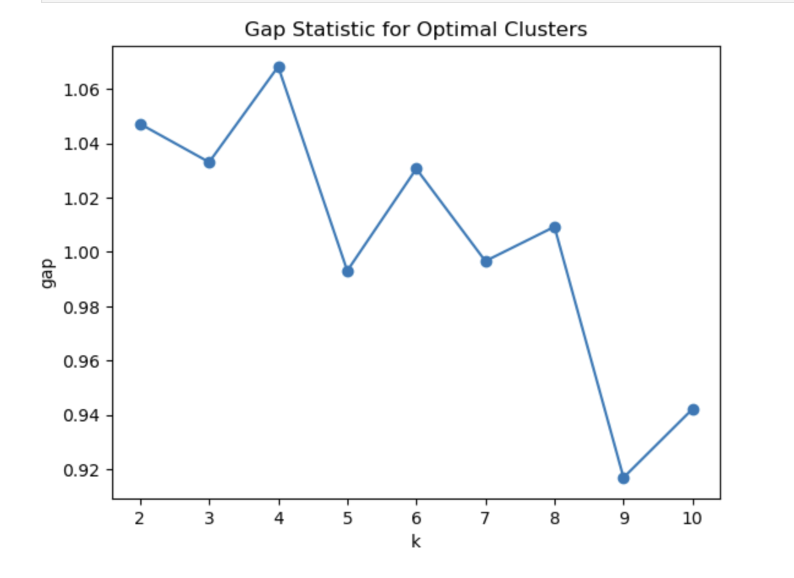
The Elbow and Silhouette Method required to optimize a K-means Model
Final Decision and Justification
Comparison: Both the Elbow and Silhouette methods suggest 3 clusters as optimal.
Justification:
Elbow Method: Clear elbow at 3 clusters, indicating a significant reduction in WCSS.
Silhouette Method: Highest silhouette score at 3 clusters, indicating well-separated and distinct clusters.
Final Decision: The optimal number of clusters for the K-means model is 3.
Summary
Using both the Elbow and Silhouette methods, we identified 3 clusters as the optimal number for our K-means model.
This ensures that the clusters are well-defined and the model is not overly complex, providing meaningful insights from the data.

Slide 8
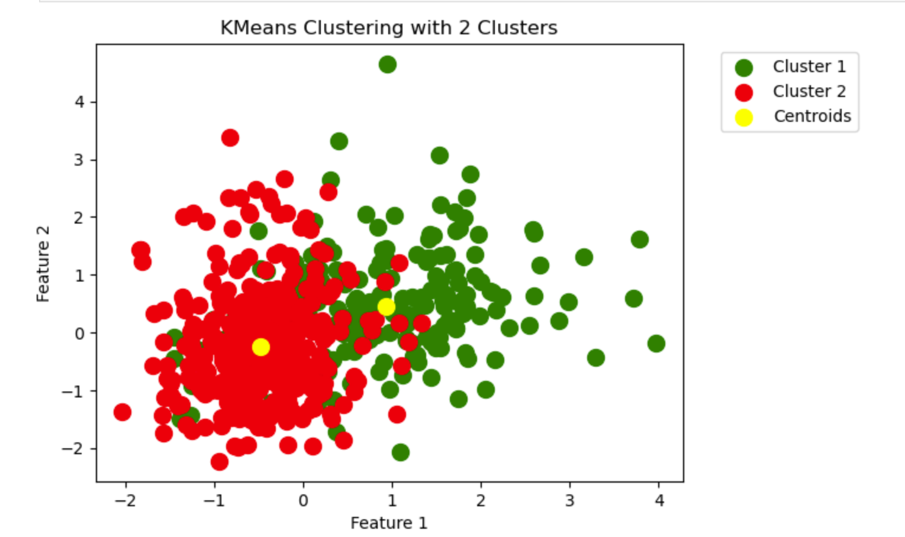
Two insights from the newly created clusters
Cluster Characteristics:
Cluster 1: This cluster is characterized by lower mean values across most features such as radius, texture, perimeter, and area. This could indicate a subset of the data with smaller and less complex observations.
Cluster 2: This cluster has moderate values in comparison to the other clusters. It represents a middle ground, possibly indicating typical or average observations within the dataset.
Cluster 3: This cluster shows the highest mean values for radius, texture, perimeter, and area. These observations are larger and more complex, possibly indicating a different subset of the data with unique characteristics.

Slide 9
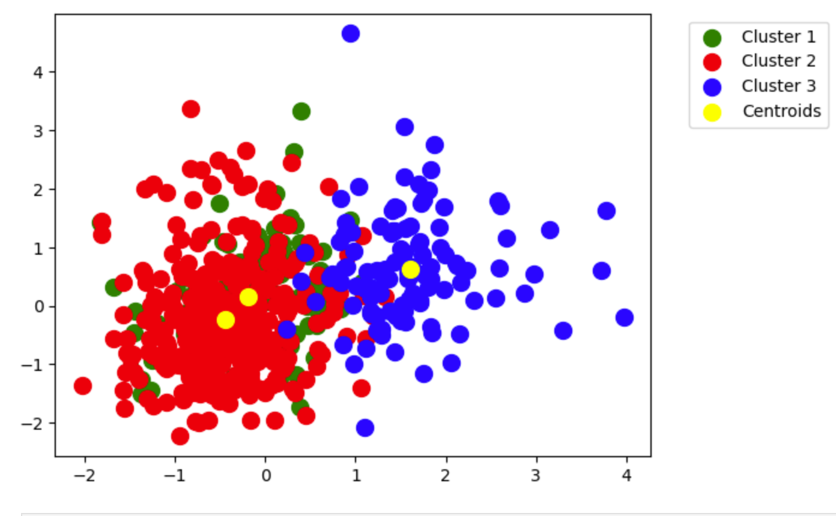
Two insights from the newly created clusters
Silhouette Scores:
The silhouette score for the clustering indicates how well each point lies within its cluster. A higher silhouette score implies better-defined clusters. The HTML file discusses different cluster counts and their corresponding silhouette scores, suggesting that the selected number of clusters provides a good balance between compactness and separation.

Slide 10

Thank you

